Slide 1
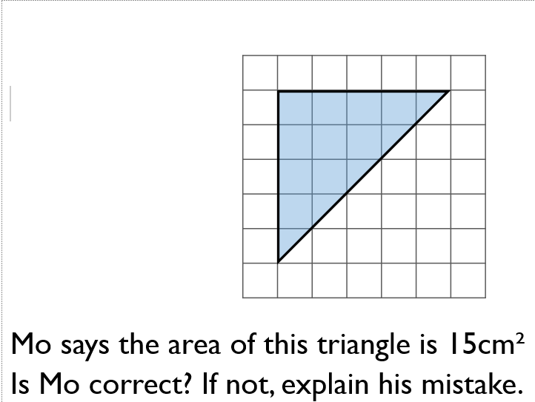
Regular Recall
Last Lesson In a box there are some red, blue and green pens. The ratio of red pens to green pens is 3 $:$ 5 For every 1 red pen there are two blue pens. Write down the ratio of red pens to blue pens to green pens. | Last Topic
Last Term Find the total of the fractions. Give your answer in its simplest form. $\frac{5}{9}$ $+$ $\frac{1}{9}= \frac{5}{9}$ $+$ $\frac{3}{9}$ $=$ $\frac{5}{9}$ $+$ $\frac{7}{9}$ $=$ Do all the answers need simplifying? Explain why. | Last Year Dora and Amir each have 100 sweets. Dora eats 65% of hers. Amir has 35 sweets left. Who has more sweets left?

